Slide 1
Iterator Design Pattern
By Steven Dix

Slide 2
Background
OO Design Pattern
Used with Collections
  Arrays
  Stacks
  Queues
  Trees
  Lists

Slide 3
Implementation

Slide 4
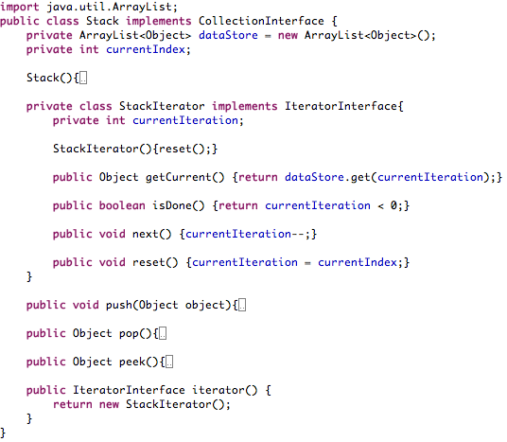

Slide 5
Operation

Slide 6
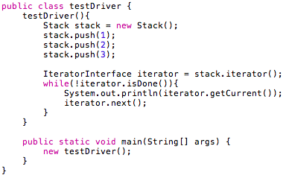

Slide 7
Benefits
  Lowers coupling between client and collection
  Increased changeability
  Supports multiple clients
Disadvantages
  Problems arise when collection changes during iteration

